Slide 1

OLAP (Online Analytical Processing)
Topic 04

Slide 2
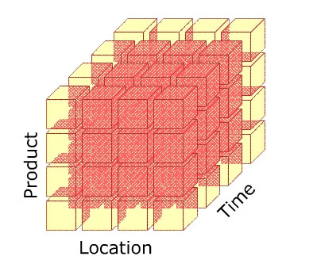
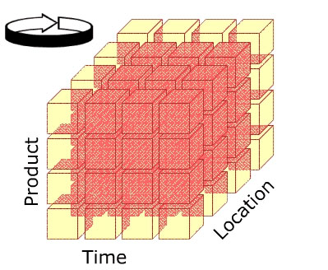
Recap
Introduction
In Topic 3, you learnt about the Dimensional model and why it is suitable to be used in a data warehouse
You also learnt how to create simple dimensional data models using the Star Schema and Snowflake schema
Star Schemas are optimized for querying large data sets and are used in data warehouses and data marts to support OLAP cubes, business intelligence and analytic applications

Slide 3
Recap
Introduction
In Topic 4, you will learn about what are OLAP cubes

Slide 4
Contents
History of OLAP
Define OLAP
OLAP Operations (Slice, Dice, Drill-down, Roll-up, Pivot)
Variations of OLAP (ROLAP, MOLAP)
Contrast OLAP and OLTP

Slide 5
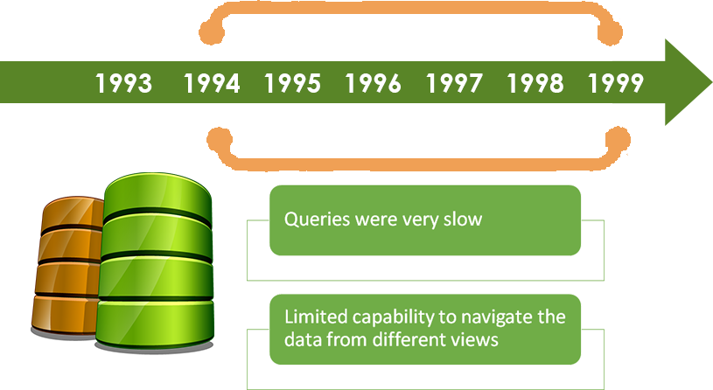
The history of OLAP
The history of OLAP
In the 1990s, as the volume of data grew, businesses found it very difficult to query data out of their relational database systems

Slide 6
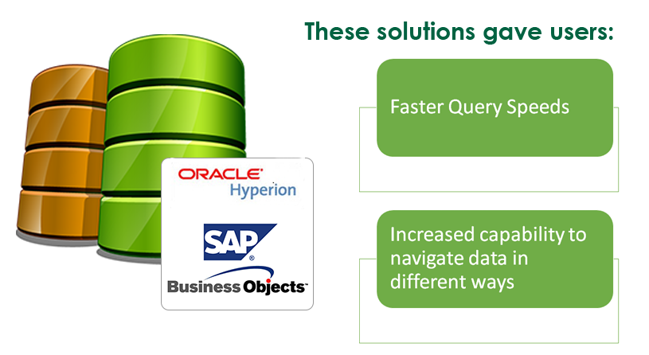
The history of OLAP
Why OLAP
Various software vendors introduced proprietary solutions to address the problem

Slide 7
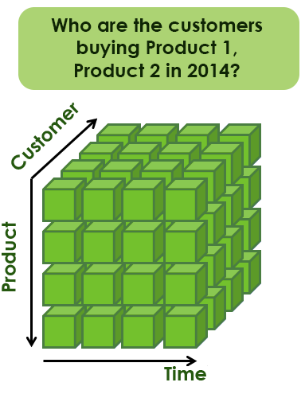
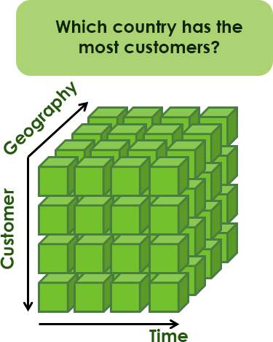
The history of OLAP
Why OLAP
How did they do that?
To achieve better speed, they had to minimize the amount of on-the-fly processing when querying a huge database
This was done by pre-processing and storing every possible combination of dimensions, measures and hierarchies before the user starts his analysis
These solutions became the basis of what we know today as OLAP

Slide 8
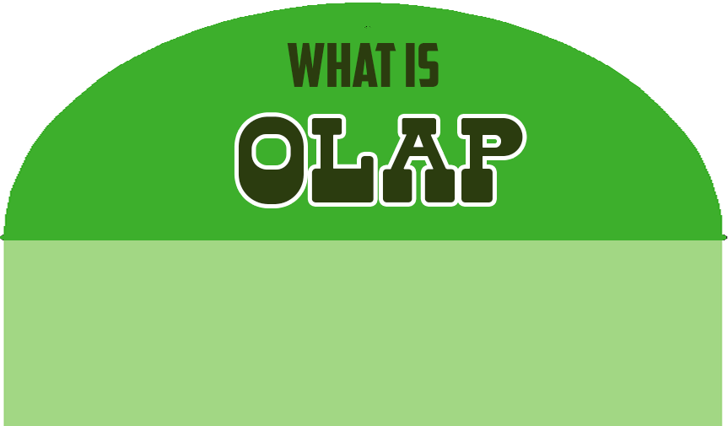
OLAP is the technology that enables business users to perform multidimensional analysis of large volumes of business data easily

Slide 9
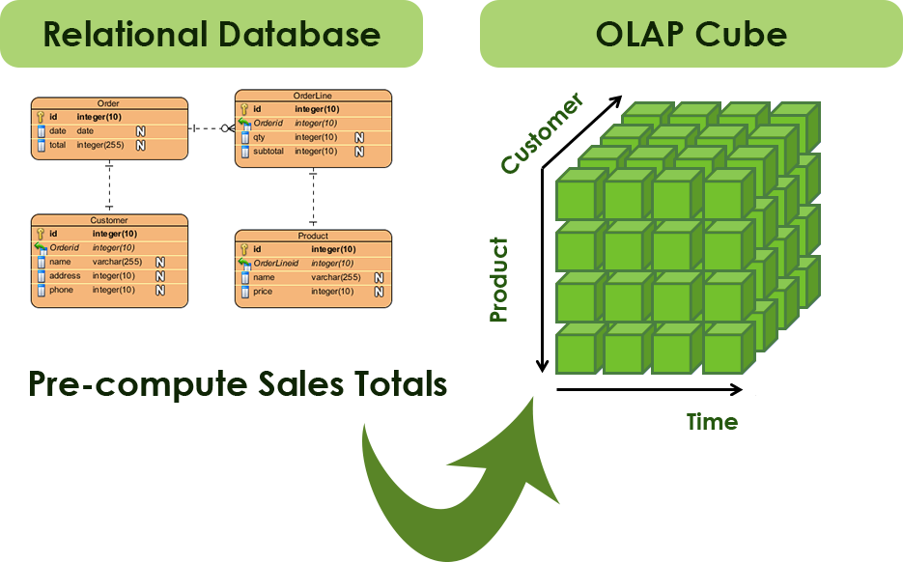
How OLAP works
How does OLAP work?
Precompute the totals and subtotals need for reporting during idle time (e.g. non-business hours)
The totals are stored in a special database called an OLAP Cube
OLAP cube does not have to loop through transactions because totals are all pre-calculated, proving instant access

Slide 10
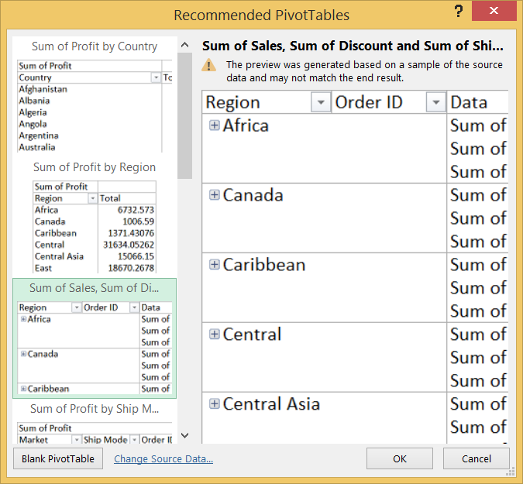
How OLAP works
How does OLAP work?
An example of a software which supports OLAP is Microsoft Excel 2013.
In Excel, you can create OLAP queries by using its PivotTable feature

Slide 11
OLAP Cube
OLAP Cube
An OLAP cube is a multi-dimensional data structure that allows fast analysis of data.
It is capable of efficiently manipulating and analysing data from multiple perspectives.
S1
S2
Salesman
220 230 250 360
140 160 105 100
50 80 70 90
Central
Area
East
South
Q1
Q2
Q3
Q4
Time
Notes:
An OLAP cube is a multi-dimensional data structure that allows fast analysis of data. It is capable of efficiently manipulating and analyzing data from multiple perspectives.
An example where a dimension can be structured into a hierarchy is the date format where it could be arranged in a hierarchy of days, months, quarters and years.
http://support.sas.com/documentation/cdl/en/olapug/59574/HTML/default/viewer.htm#a002254427.htm

Slide 12
OLAP Cube
OLAP Cube
An OLAP cube consists of measures and dimensions
Measures are numeric values that businesses typically track e.g. Revenue
Dimensions are values that identify and categorize the data, e.g. Product, Time, Geography
A dimension can be organised as a hierarchy, e.g. data stored in the Time dimension such as 01 Dec 2014 can be sub-categorised into Year (2014), Month (Dec), Day (01) ,Quarter (4) etc
Notes:
An OLAP cube is a multi-dimensional data structure that allows fast analysis of data. It is capable of efficiently manipulating and analyzing data from multiple perspectives.

Slide 13
OLAP Operations
OLAP Operations
OLAP tools such as Excel allow the user to obtain different views of the same data by performing actions known as OLAP operations
There are 5 basic OLAP operations that are supported by most OLAP software
Slice
Dice
Roll-up
Drill-down
Pivot (Rotate)

Slide 14
OLAP Operations
OLAP Operations
Slice
Apply a filter on one dimension to create a slice of data
Dice
Apply a filter on two dimensions to create a smaller cube (subset)
Drill-down
Display detailed information (opposite of roll-up)
Roll-up
Display aggregated information (opposite of drill-down)
Pivot
Rotate the cube (switch the axes)

Slide 15
Slice
OLAP Operations

Slide 16
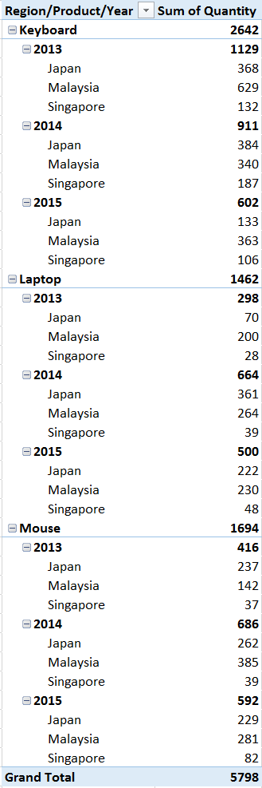
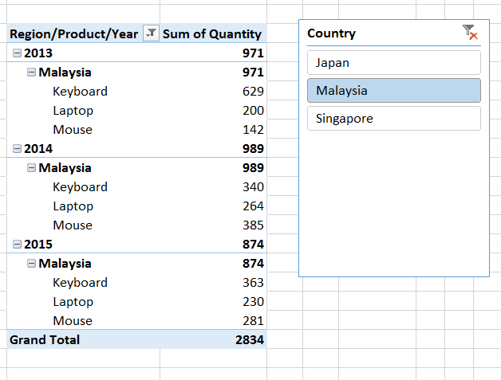
Slice
OLAP Operations

Slide 17
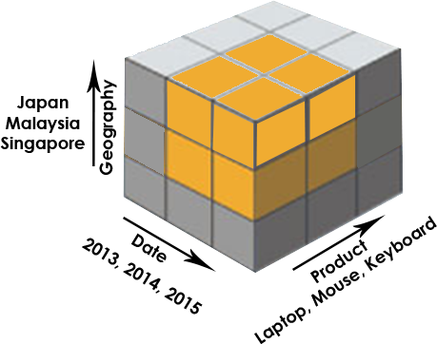
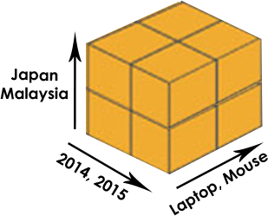
Dice
OLAP Operations

Slide 18
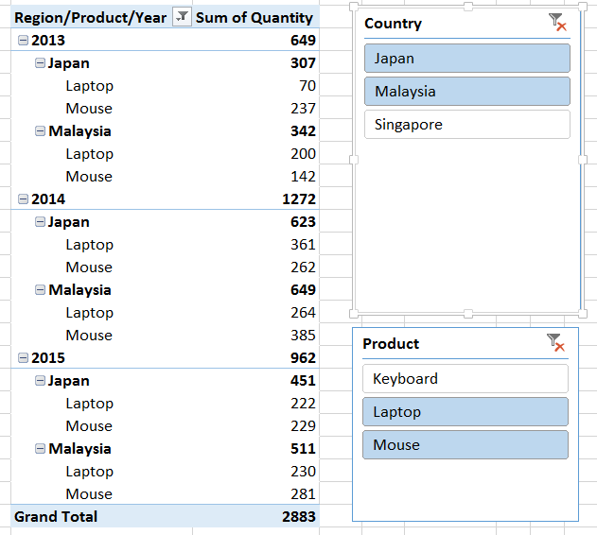
Dice
OLAP Operations

Slide 19
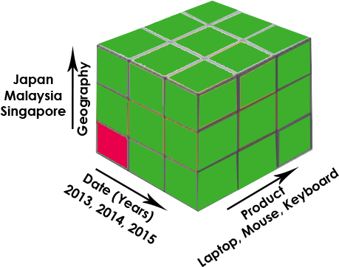
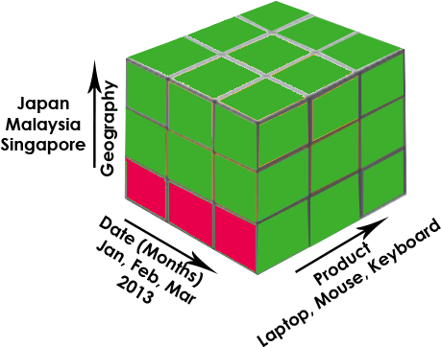
Drill-down
OLAP Operations

Slide 20
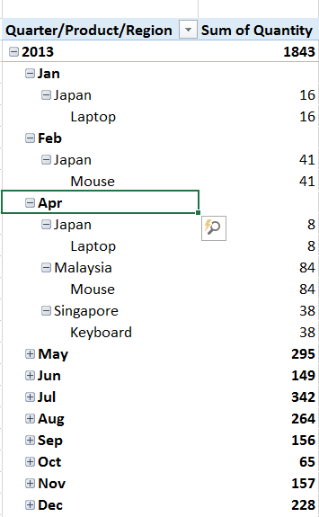
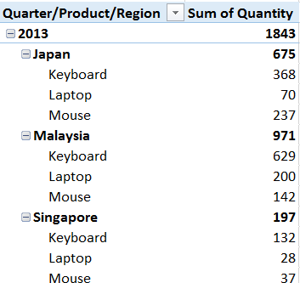
Drill-down
OLAP Operations

Slide 21
Roll-up
OLAP Operations

Slide 22
Roll-up
OLAP Operations

Slide 23
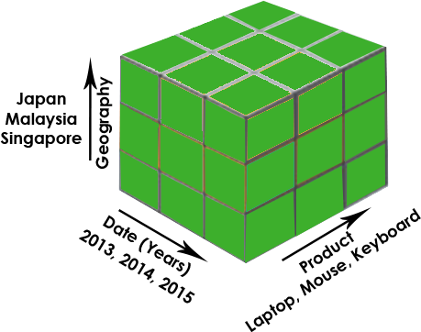
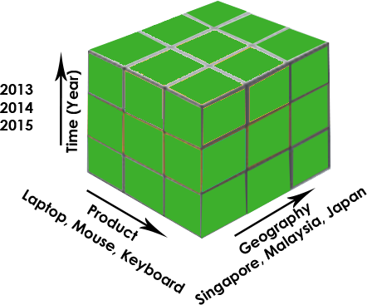
Pivot
OLAP Operations

Slide 24
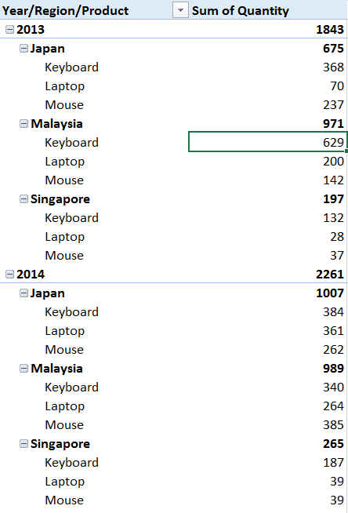
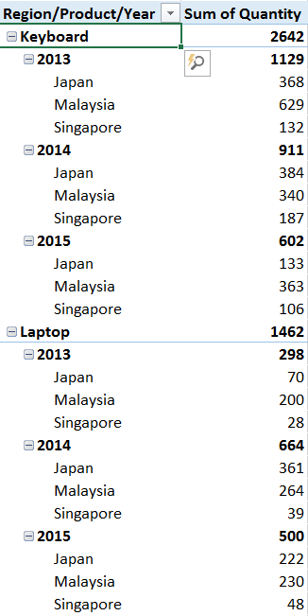
Pivot
OLAP Operations
Performance by year Which year did we have the most sales for all products? In 2013, which country sold the most products?
Performance by product What is the product that has the most sales?
How many laptops were sold in 2014?

Slide 25
Variations of OLAP
Variations of OLAP
OLAP systems vary quite a lot and they have generally been distinguished by a letter tagged onto the front of the acronym “OLAP”
MOLAP (Multidimensional OLAP) and ROLAP (Relational OLAP) have classically been the most established types
There is also HOLAP (Hybrid OLAP), a combination of MOLAP and ROLAP
There are other vendor-specific variations such as SOLAP (Spatial OLAP) and DOLAP (Desktop OLAP)

Slide 26
MOLAP
Variations of OLAP
MOLAP stands for Multi-dimensional OLAP
More traditional way where data is stored in a multidimensional cube
Storage is not in the relational database, but in proprietary formats

Slide 27
MOLAP
Variations of OLAP
Advantage | Disadvantage
Excellent performance: MOLAP cubes are built for fast data retrieval, and are optimal for slicing and dicing operations. | Limited in the amount of data it can handle: Because all calculations are performed when the cube is built, it is not possible to include a large amount of data in the cube itself.
Can perform complex calculations: All calculations have been pre-generated when the cube is created. Hence, complex calculations are not only doable, but they return quickly. | Requires additional investment: Cube technology are often proprietary and do not already exist in the organization. Therefore, to adopt MOLAP technology, chances are additional investments in human and capital resources are needed.

Slide 28
ROLAP
Variations of OLAP
ROLAP stands for Relational OLAP
Manipulates the data stored in the relational database to give the appearance of traditional OLAP's slicing and dicing functionality
In essence, each action of slicing and dicing is equivalent to adding a "WHERE" clause in the SQL statement.

Slide 29
ROLAP
Variations of OLAP
Advantage | Disadvantage
Can handle large amounts of data: The data size limitation of ROLAP technology is the limitation on data size of the underlying relational database. In other words, ROLAP itself places no limitation on data amount | Slow performance: ROLAP gives the poorest query performance because no objects benefit from multidimensional storage
Can leverage functionalities inherent in the relational database: Often, relational database already comes with a host of functionalities. ROLAP technologies, since they sit on top of the relational database, can therefore leverage these functionalities | Limited by SQL functionality: Since ROLAP technology mainly relies on generating SQL statements to query the relational database, ROLAP technologies are limited by what SQL can do. Vendors enhance their SQL engines to overcome this problem

Slide 30

Components of MOLAP tool
Variations of OLAP
MOLAP
server
Request
Load
Result
Presentation
layer
Database
layer
Application
layer
MOLAP servers support and operate on multidimensional data structures. Example of MOLAP tools are Oracle ESSBase and IBM Cognos TM1

Slide 31
Components of ROLAP tool
Variations of OLAP
ROLAP
server
Request
SQL
Result
Result
Database
layer
Application
layer
Presentation
layer
ROLAP products have enhanced SQL engines to support the complexity of multi-dimensional analysis. Examples of ROLAP tools are Information Advantage’s Axsys and Sybase’s HighGate Project.

Slide 32
 | OLTP | OLAP
Purpose | Carry out day-to-day business functions | Support decision-making and provide answers to business and management queries
Data Source | Transaction database (Normalized data repository focused on efficiency and consistency) | Data warehouse or data mart (a non-normalized data repository primarily focused on accuracy and completeness)
Reporting | Routine, periodic, narrowly focused reports | Ad-hoc, multi-dimensional, broadly focused reports and queries
Resource Requirements | Ordinary relational databases | Multi-processor, large capacity specialized databases
Execution Speed | Fast (Recording of business transactions and routine reports) | Slow (Resource intensive, complex, large-scale queries)

Slide 33
Review Question 1: OLAP Cube
Review Questions
Explain what an OLAP cube is.
Give an example where a dimension can be structured into a “hierarchy”
Notes:
An OLAP Cube is a data structure that stores data as a multi-dimensional array to enable fast analysis of data. For example, an OLAP cube can store Sales Data based on dimensions such as Customer, Product, Time, Location, and allow questions such as “What is the total sales for Product X for Location Y in Year Z” to be answered very quickly as the data is already pre-calculated and stored in the multi-dimensional array.
An example where a dimension can be structured into a hierarchy is Time
Year->Quarter->Month

Slide 34
Review Question 2: OLAP
Review Questions
Salesman id | Area | Time | Total revenue (S$)
S2 | Central | Quarter 1 (Q1) | 220
S2 | East | Quarter 1 (Q1) | 140
S2 | South | Quarter 1 (Q1) | 50
S2 | Central | Quarter 2 (Q2) | 230
S2 | East | Quarter 2 (Q2) | 160
S2 | South | Quarter 2 (Q2) | 80
S2 | Central | Quarter 3 (Q3) | 250
S2 | East | Quarter 3 (Q3) | 105
S2 | South | Quarter 3 (Q3) | 70
S2 | Central | Quarter 4 (Q4) | 360
S2 | East | Quarter 4 (Q4) | 100
S2 | South | Quarter 4 (Q4) | 90
S1 | Central | Quarter 1 (Q1) | 222
How many dimensions are there?
If all the cells have values, determine the number of cells with values. Show your working.
Draw a cube based on Table 1. Label the dimensions and fill-in any 12 values given.
Table 1: A four-field table
Notes:
3x4x2=24

Slide 35
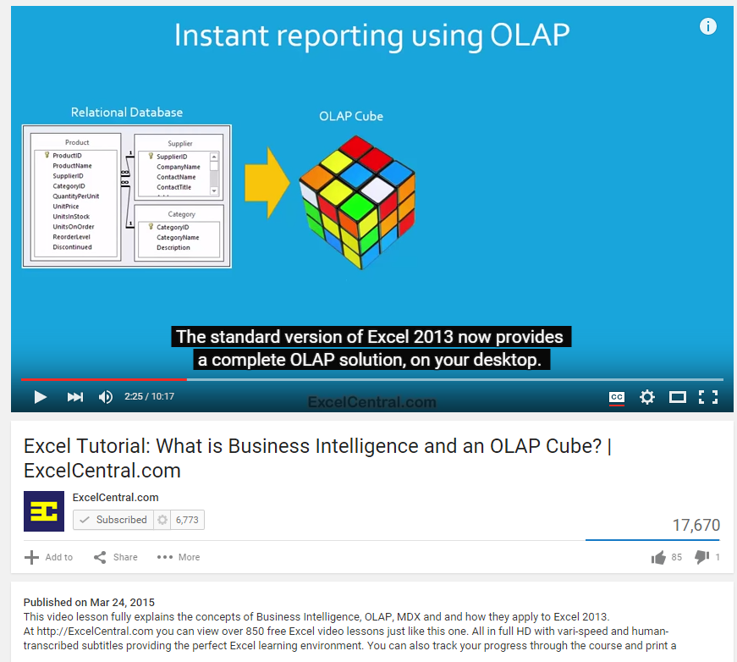
https://www.youtube.com/watch?v=yoE6bgJv08E

